Slide 1
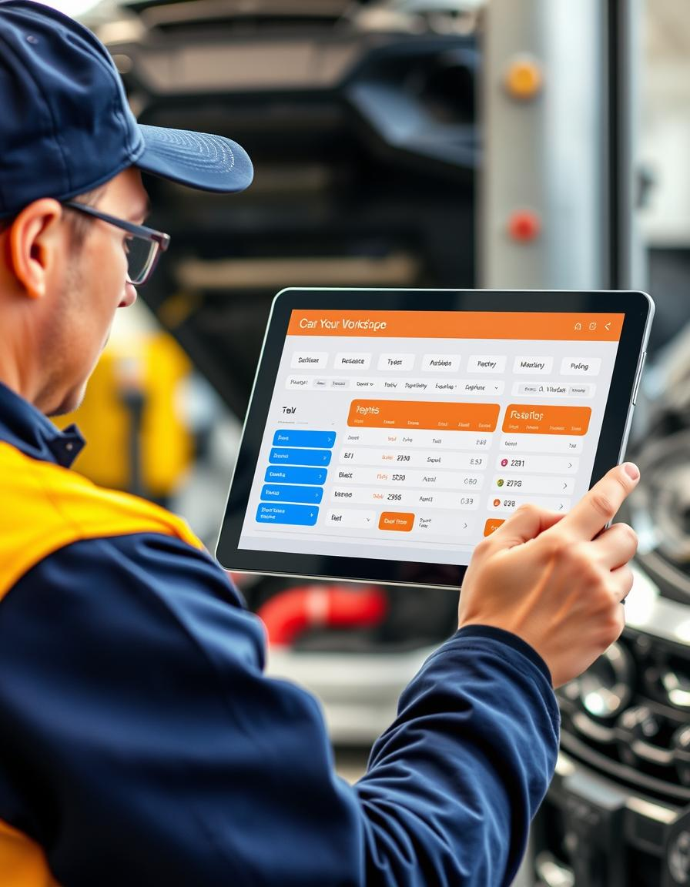

Car Workshop Reservation -A Revolutionary Solution
Welcome! Our team is proud to present a revolutionary car workshop reservation system designed to streamline scheduling and enhance the average customer experiences

Slide 2
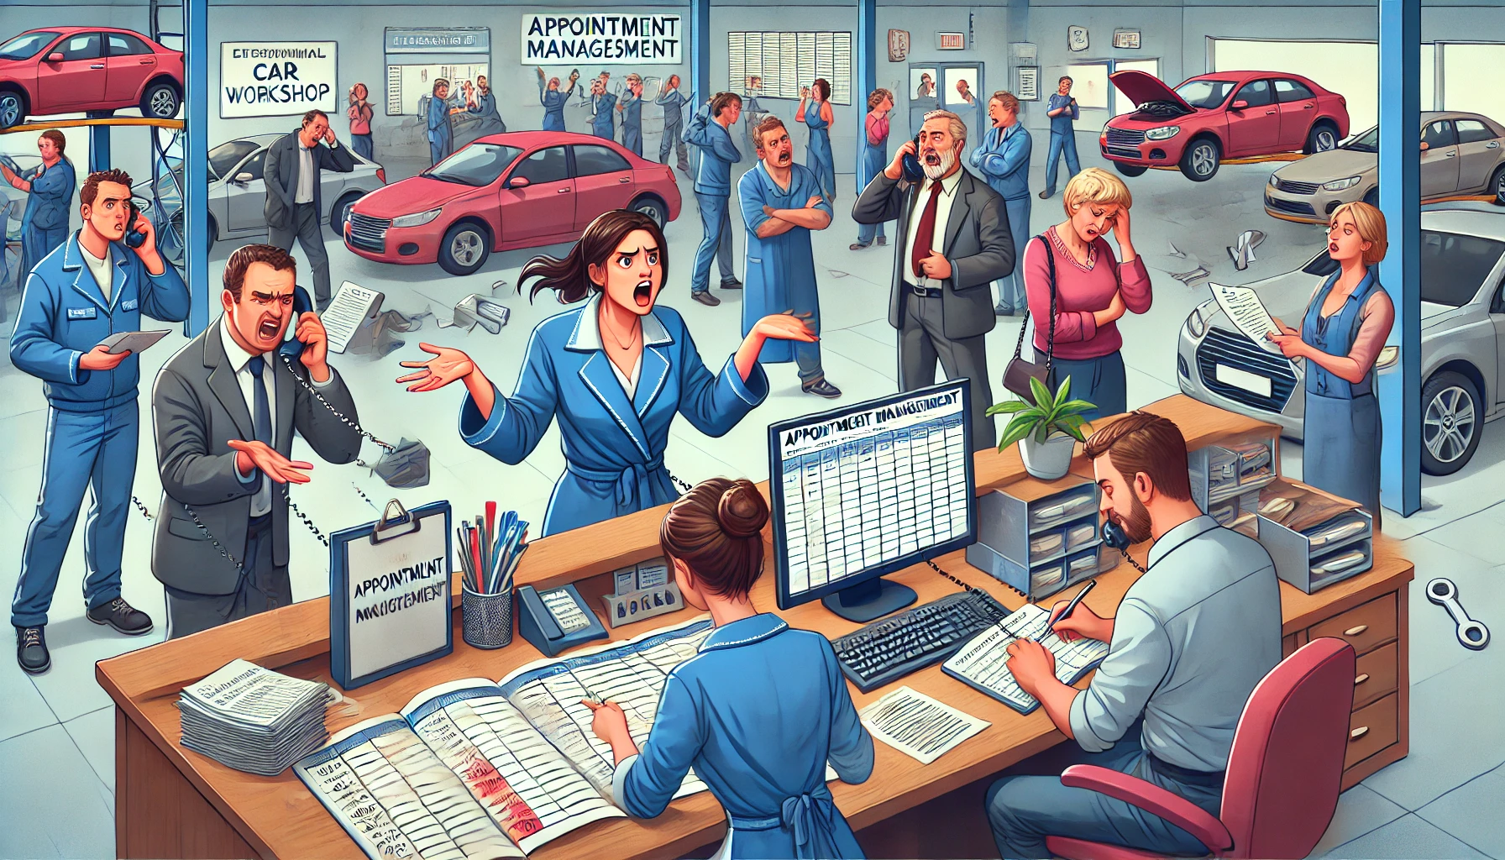
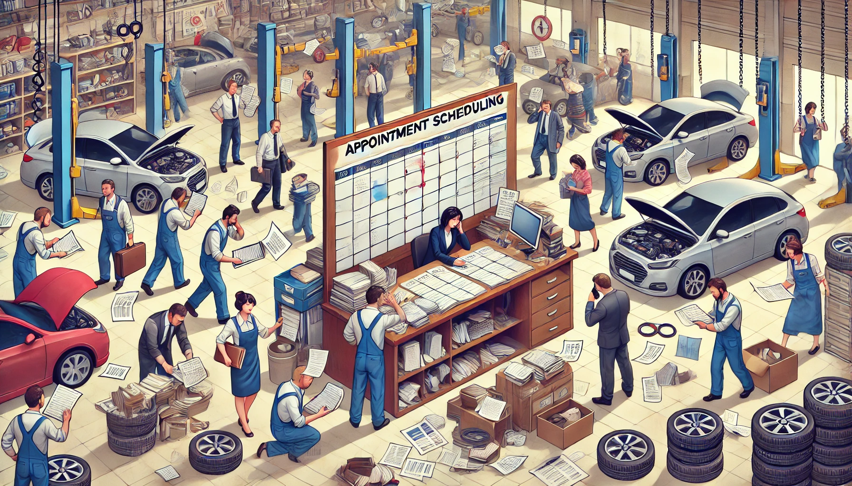
The Problem of Manual Scheduling
Traditional car workshops rely on manual scheduling methods, leading to long wait times, double bookings, and communication breakdowns. These issues create frustration for both customers and workshop staff.
Workshops struggle to manage appointments efficiently, resulting in missed opportunities and lost revenue. Customers face inconvenience and uncertainty, leading to dissatisfaction and potential loss of business.

Slide 3
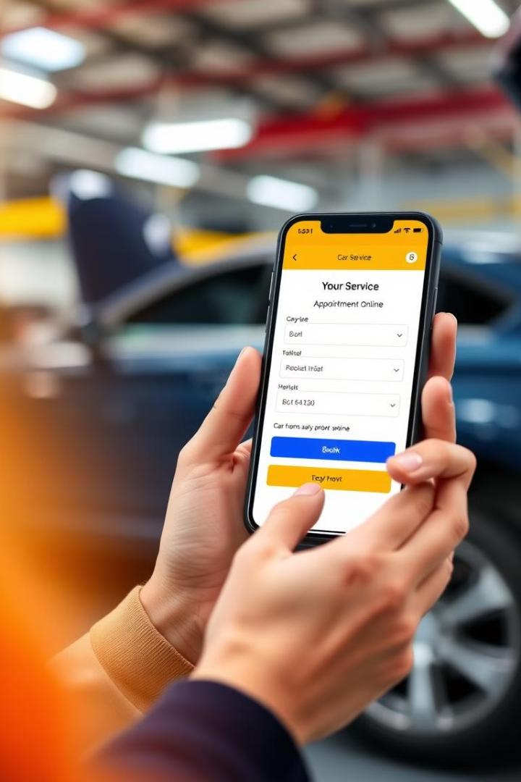
Our Solution: A Digital Revolution
1
1. Online Booking
2
2. Automated Scheduling
Our system enables customers to browse available services and time slots online, making booking hassle-free and convenient.
The platform automates scheduling, eliminating human errors and ensuring accurate appointment allocation.
3
3. Real-Time Service Tracking
Customers will receive real-time updates about their appointment status and payments through the system.

Slide 4
System Architecture and Design
Our system utilizes a Java-based standalone application, offering robust functionality and seamless integration with existing workshop systems.
The ER Diagram showcases how users, services, workshops, and appointments interact within our database. The diagram depicts key relationships and data flow between different system components.

Slide 5
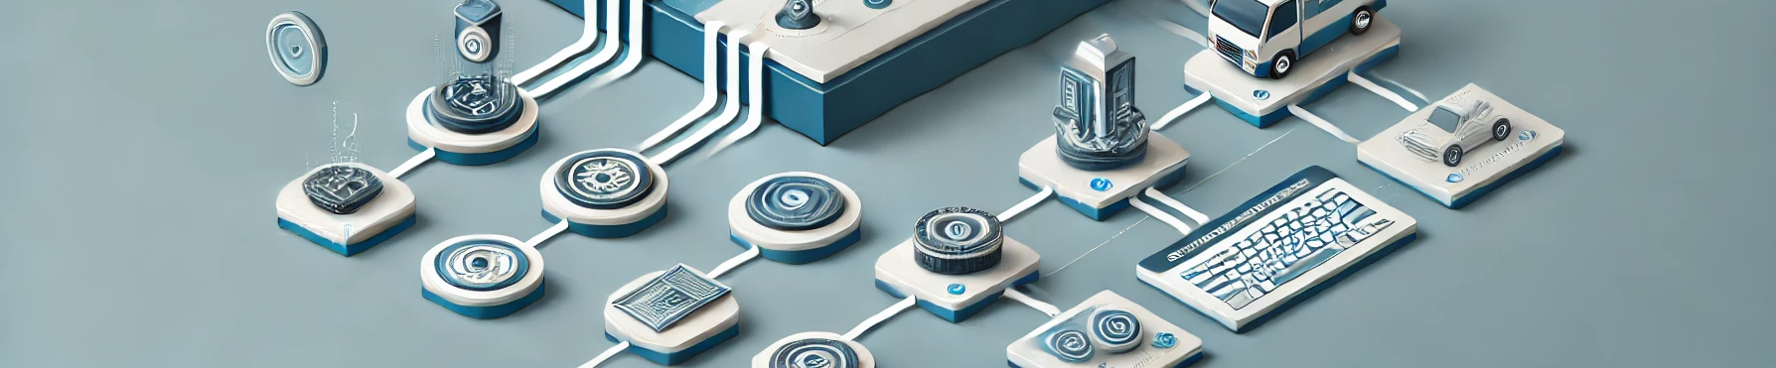
Technical Flow: Streamlining Operations
Our system employs a user-friendly interface, guiding customers through the booking process effortlessly. The user selects a desired service and time slot, and the system automatically checks for availability.
Upon booking confirmation, the system stores the appointment in the database, and sends a confirmation notification to the user.
1
2
3
The system validates user login credentials and confirms the availability of chosen services and time slots, preventing scheduling conflicts.

Slide 6
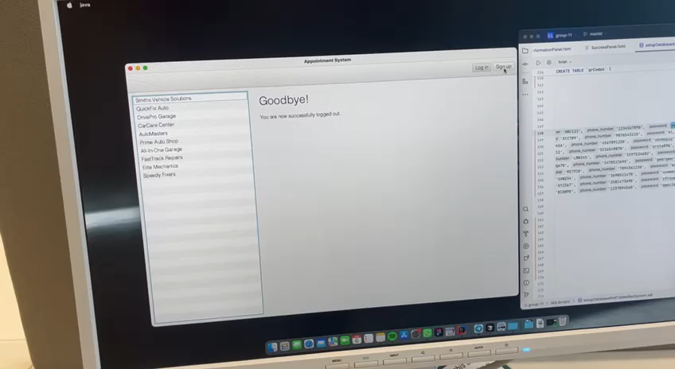
A glance at our software: Sign-up function

Slide 7
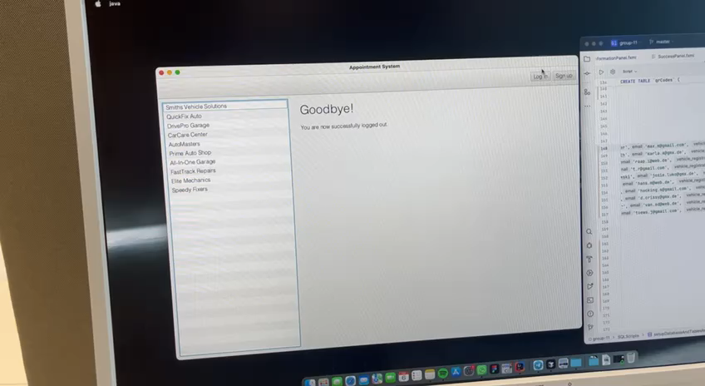
A glance at our software: Log-in & Profile functions

Slide 8
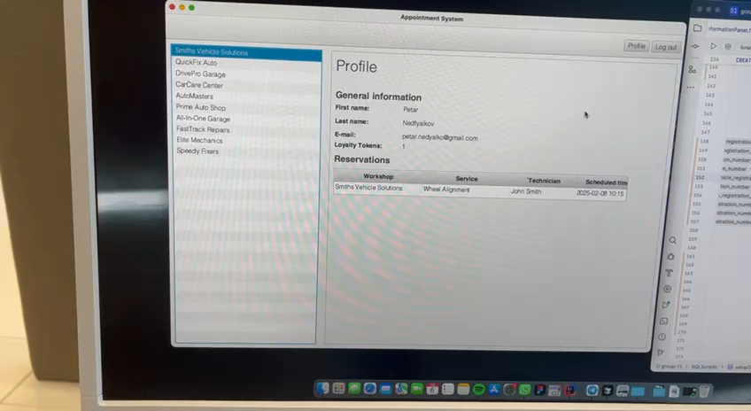
A glance at our software: Reservation function

Slide 9

Impact & Scalability: Shaping the Future
30%
90%
Faster Scheduling
Error Reduction
Our system significantly reduces scheduling time, freeing up staff to focus on core workshop operations.
Automated scheduling minimizes human errors, improving accuracy and ensuring efficient resource allocation.
∞
Scalability
The system is designed to scale seamlessly, catering to both small workshops and larger chains nationwide.

Slide 10



Investment Opportunity: Join the Revolution
Reduced Costs
1
Our system optimizes workflow and resource utilization, leading to cost savings for workshops.
Enhanced Customer Experience
2
Customers enjoy a streamlined and convenient experience, leading to increased satisfaction and loyalty.
Improved Efficiency
3
Automated scheduling and streamlined processes empower workshops to operate more efficiently and effectively.

Slide 11
Future Vision: AI-Powered Innovation
AI-powered Scheduling
1
Integrating AI into our system can further optimize scheduling, predicting demand and suggesting optimal time slots.
Predictive Maintenance
2
By analyzing data, the system can proactively identify potential maintenance needs, reducing downtime and enhancing preventative care.
Integrated Payment Solutions
3
The system can be expanded to include secure online payment options, simplifying the booking and payment process.

Slide 12








Join us: Invest in Innovation
We are confident that our car workshop reservation system offers a compelling investment opportunity. By supporting our project, you'll be investing in a solution that transforms the industry and enhances the customer experience.
Developed by
Amir Amangeldiyev
Zeinelabeddine Zayoun
Petar Nedyalkov
Mher Avetisyan
Chingiz Kuanyshbay
Anton Averianov
Sadeem Nasr
Noel Leon Görmez

